Slide 1
Markov Chain Monte Carlo
MCMC (Markov chain Monte Carlo) is a family of randomized algorithms for approximating some quantity of interest over a very large state space
Markov chain = a sequence of randomly chosen states (“random walk”), where each state is chosen conditioned on the previous state
Monte Carlo = an algorithm (usually based on sampling) that has some probability of producing an incorrect answer
MCMC = wander around for a bit, average what you see

Slide 2
Gibbs sampling
A particular kind of MCMC
States are complete assignments to all variables
(Cf local search: closely related to simulated annealing!)
Evidence variables remain fixed, other variables change
To generate the next state, pick a variable and sample a value for it conditioned on all the other variables: X_{i}’ ~ P(X_{i} | x₁,..,x_{i-1},x_{i+1},..,x_{n})
Will tend to move towards states of higher probability, but can go down too
In a Bayes net, P(X_{i} | x₁,..,x_{i-1},x_{i+1},..,x_{n}) = P(X_{i} | markov_blanket(X_{i}))
Theorem: Gibbs sampling is consistent*
Provided all Gibbs distributions are bounded away from 0 and 1 and variable selection is fair

Slide 3
Advantages of MCMC
Samples soon begin to reflect all the evidence in the network
Eventually they are being drawn from the true posterior!

Slide 4
Car Insurance: P(PropertyCost | e)

Slide 5
Car Insurance: P(PropertyCost | e)

Slide 6
Gibbs sampling algorithm
Repeat many times
Sample a non-evidence variable X_{i} from
P(X_{i} | x₁,..,x_{i-1},x_{i+1},..,x_{n}) = P(X_{i} | markov_blanket(X_{i}))
= α P(X_{i} | parents (X_{i})) ∏_{j} P(y_{j} | parents(Y_{j}))

Slide 7
Gibbs Sampling Example: P( S | r)
Step 1: Fix evidence
R = true
Step 3: Repeat
Choose a non-evidence variable X
Resample X from P(X | markov_blanket(X))
Step 2: Initialize other variables
Randomly
C
C
S
r
S
r
W
W
C
C
C
C
C
C
S
r
S
r
S
r
S
r
S
r
S
r
W
W
W
W
W
W
Sample S ~ P(S | c, r, ¬w)
Sample C ~ P(C | s, r)
Sample W ~ P(W | s, r)
Notes:
Better animation

Slide 8
Markov chain given s, w

Slide 9
Gibbs sampling and MCMC in practice
The most commonly used method for large Bayes nets
See, e.g., BUGS, JAGS, STAN, infer.net, BLOG, etc.
Can be compiled to run very fast
Eliminate all data structure references, just multiply and sample
~100 million samples per second on a laptop
Can run asynchronously in parallel (one processor per variable)
Many cognitive scientists suggest the brain runs on MCMC

Slide 10
Consistency of Gibbs (see AIMA 13.4.2 for details)
Suppose we run it for a long time and predict the probability of reaching any given state at time t: π_{t}(x₁,...,x_{n}) or π_{t}(x)
Each Gibbs sampling step (pick a variable, resample its value) applied to a state x has a probability k(x’ | x) of reaching a next state x’
So π_{t+1}(x’) = ∑_{x} k(x’ | x) π_{t}(x) or, in matrix/vector form π_{t+1} = Kπ_{t}
When the process is in equilibrium π_{t+1} = π_{t} = π so Kπ = π
This has a unique* solution π = P(x₁,...,x_{n} | e₁,...,e_{k})
* Markov chain must be ergodic, i.e., completely connected and aperiodic
Satisfied if all probabilities are bounded away from 0 and 1
So for large enough t the next sample will be drawn from the true posterior
“Large enough” depends on CPTs in the Bayes net; takes longer if nearly deterministic

Slide 11
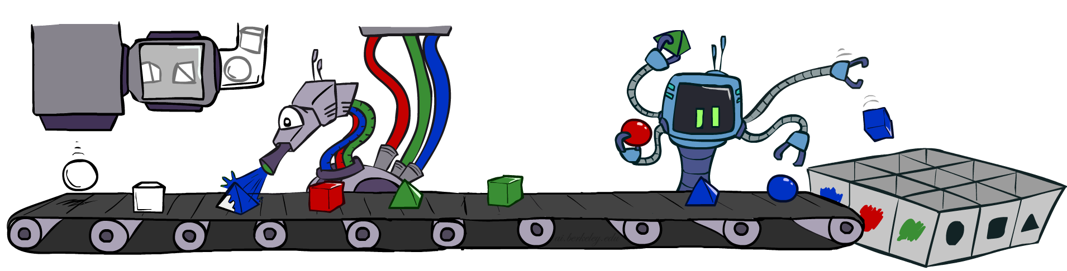
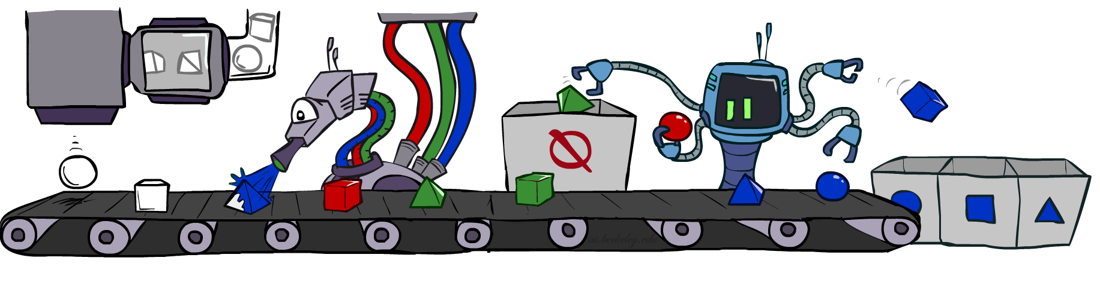

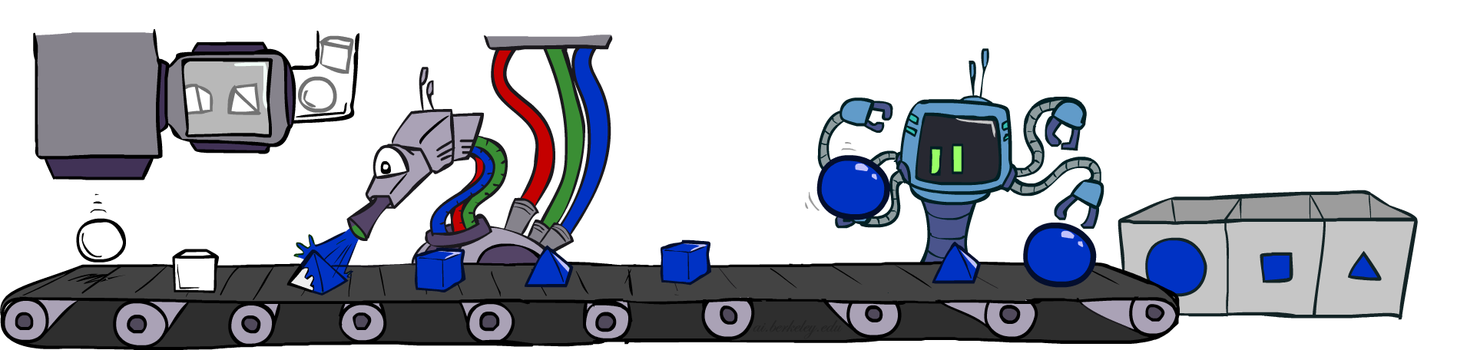
Bayes Net Sampling Summary
Prior Sampling P :
Generate complete samples from P(x₁,…,x_{n})
Likelihood Weighting P(Q | e) :
Weight samples by how well they predict e
Rejection Sampling P(Q | e) :
Reject samples that don’t match e
Gibbs sampling P(Q | e) :
Wander around in e space
Average what you see

Slide 12
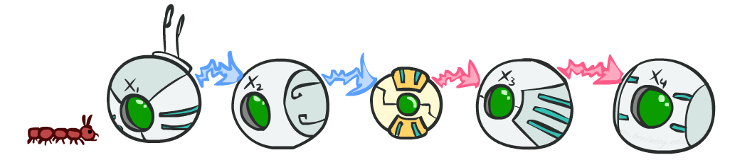
CS 188: Artificial Intelligence
Markov Models
Instructors: Stuart Russell and Peyrin Kao
University of California, Berkeley
Notes:
Please retain proper attribution, including the reference to ai.berkeley.edu. Thanks!
Note: pretty short lecture, good one to present mini-contest results or anything else not exactly lecture.

Slide 13
Uncertainty and Time
Often, we want to reason about a sequence of observations where the state of the underlying system is changing
Speech recognition
Robot localization
User attention
Medical monitoring
Global climate
Need to introduce time into our models

Slide 14
Markov Models (aka Markov chain/process)
Value of X at a given time is called the state (usually discrete, finite)
The transition model P(X_{t} | X_{t-1}) specifies how the state evolves over time
Stationarity assumption: transition probabilities are the same at all times
Markov assumption: “future is independent of the past given the present”
X_{t+1} is independent of X₀,…, X_{t-1} given X_{t}
This is a first-order Markov model (a kth-order model allows dependencies on k earlier steps)
Joint distribution P(X₀,…, X_{T}) = P(X₀) ∏_{t} P(X_{t} | X_{t-1})
X₀
X₁
X₂
X₃
P(X₀)
P(X_{t} | X_{t-1})

Slide 15
Quiz: are Markov models a special case of Bayes nets?
Yes and no!
Yes:
Directed acyclic graph, joint = product of conditionals
No:
Infinitely many variables (unless we truncate)
Repetition of transition model not part of standard Bayes net syntax

Slide 16
Example: Random walk in one dimension
-4
-3
-2
-1
0
1
2
3
4
State: location on the unbounded integer line
Initial probability: starts at 0
Transition model: P(X_{t} = k| X_{t-1}= k±1) = 0.5
Applications: particle motion in crystals, stock prices, gambling, genetics, etc.
Questions:
How far does it get as a function of t?
Expected distance is O(√t)
Does it get back to 0 or can it go off for ever and not come back?
In 1D and 2D, returns w.p. 1; in 3D, returns w.p. 0.34053733

Slide 17
Example: n-gram models
We call ourselves Homo sapiens—man the wise—because our intelligence is so important to us.
For thousands of years, we have tried to understand how we think; that is, how a mere handful of matter can
perceive, understand, predict, and manipulate a world far larger and more complicated than itself. ….
State: word at position t in text (can also build letter n-grams)
Transition model (probabilities come from empirical frequencies):
Unigram (zero-order): P(Word_{t} = i)
“logical are as are confusion a may right tries agent goal the was . . .”
Bigram (first-order): P(Word_{t} = i | Word_{t-1}= j)
“systems are very similar computational approach would be represented . . .”
Trigram (second-order): P(Word_{t} = i | Word_{t-1}= j, Word_{t-2}= k)
“planning and scheduling are integrated the success of naive bayes model is . . .”
Applications: text classification, spam detection, author identification, language classification, speech recognition

Slide 18
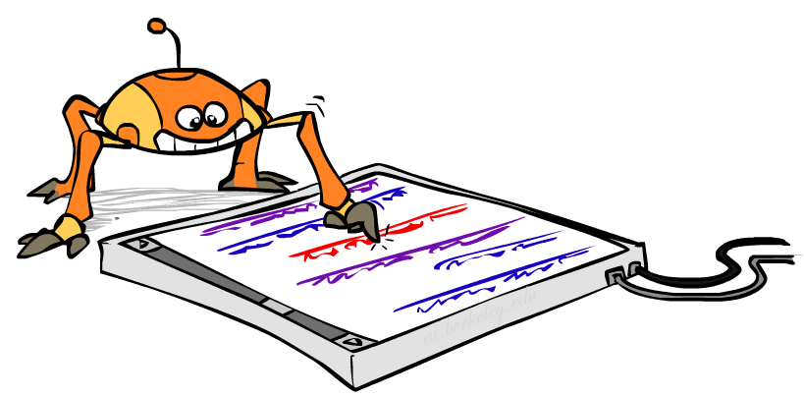
Example: Web browsing
State: URL visited at step t
Transition model:
With probability p, choose an outgoing link at random
With probability (1-p), choose an arbitrary new page
Question: What is the stationary distribution over pages?
I.e., if the process runs forever, what fraction of time does it spend in any given page?
Application: Google page rank

Slide 19
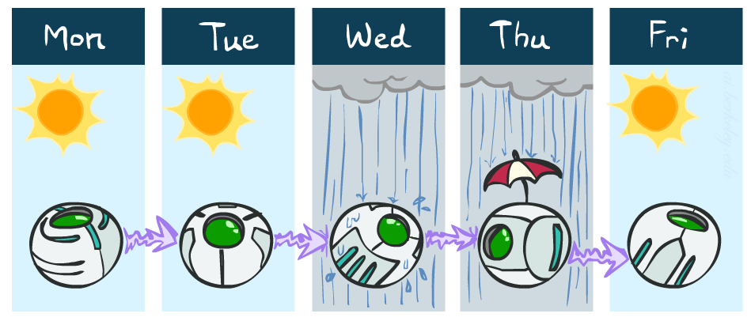
Example: Weather
States {rain, sun}
Initial distribution P(X₀)
Transition model P(X_{t} | X_{t-1})
P(X₀)
sun | rain
0.5 | 0.5
Two new ways of representing the same CPT
0.9
0.3
0.9
X_{t-1} | P(X_{t}|X_{t-1})
 | sun | rain
sun | 0.9 | 0.1
rain | 0.3 | 0.7
rain
sun
sun
sun
0.1
0.3
rain
rain
0.7
0.7
0.1

